Slide 1
Chapter 4 – The Advanced Encryption Standard (AES)

Slide 2
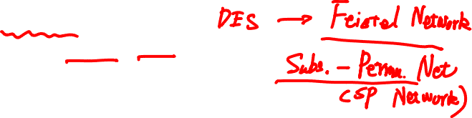
Content of this Chapter
Overview of the AES algorithm
Internal structure of AES
Byte Substitution layer
Diffusion layer
Key Addition layer
Key schedule
Decryption
Practical issues

Slide 3
Content of this Chapter
Overview of the AES algorithm
Internal structure of AES
Byte Substitution layer
Diffusion layer
Key Addition layer
Key schedule
Decryption
Practical issues

Slide 4

Some Basic Facts
AES is the most widely used symmetric cipher today
The algorithm for AES was chosen by the US National Institute of Standards and Technology (NIST) in a multi-year selection process
The requirements for all AES candidate submissions were:
Block cipher with 128-bit block size
Three supported key lengths: 128, 192 and 256 bit
Security relative to other submitted algorithms
Efficiency in software and hardware

Slide 5
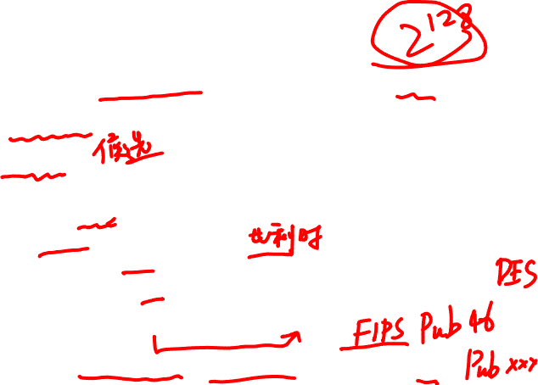
Chronology of the AES Selection
The need for a new block cipher announced by NIST in January, 1997
15 candidates algorithms accepted in August, 1998
5 finalists announced in August, 1999:
Mars – IBM Corporation
RC6 – RSA Laboratories
Rijndael – J. Daemen & V. Rijmen
Serpent – Eli Biham et al.
Twofish – B. Schneier et al.
In October 2000, Rijndael was chosen as the AES
AES was formally approved as a US federal standard in November 2001

Slide 6
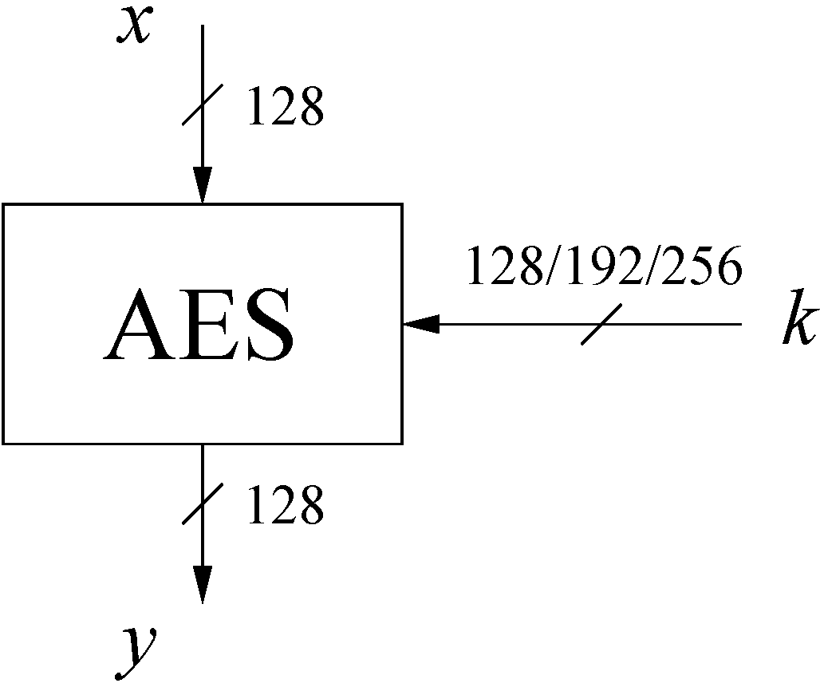
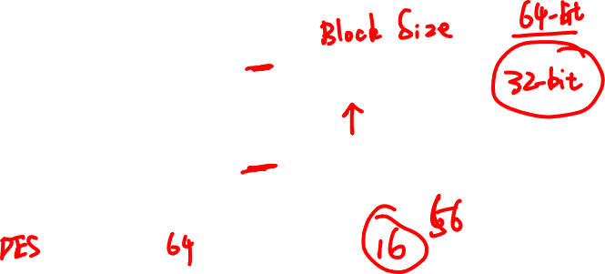
AES: Overview
The number of rounds depends on the chosen key length:
Key length (bits) | Number of rounds
128 | 10
192 | 12
256 | 14

Slide 7
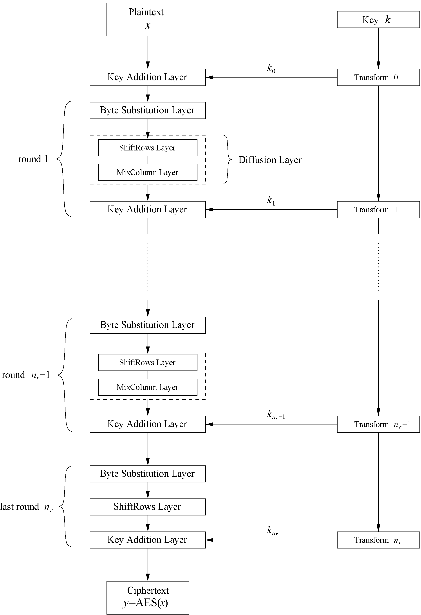
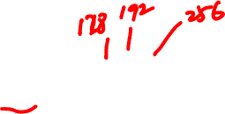
AES: Overview
Iterated cipher with 10/12/14 rounds
Each round consists of “Layers”

Slide 8
Content of this Chapter
Overview of the AES algorithm
Internal structure of AES
Byte Substitution layer
Diffusion layer
Key Addition layer
Key schedule
Decryption
Practical issues

Slide 9
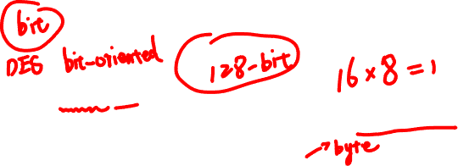
Internal Structure of AES
AES is a byte-oriented cipher
The state A (i.e., the 128-bit data path) can be arranged in a 4x4 matrix:
with A₀,…, A₁₅ denoting the 16-byte input of AES
A₀ | A₄ | A₈ | A₁₂
A₁ | A₅ | A₉ | A₁₃
A₂ | A₆ | A₁₀ | A₁₄
A₃ | A₇ | A₁₁ | A₁₅

Slide 10
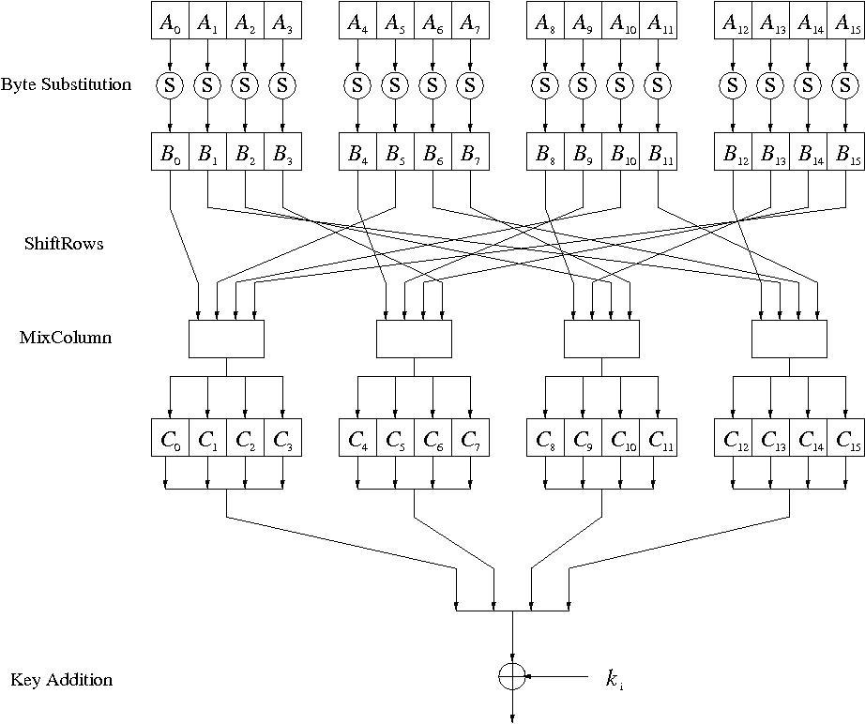
Internal Structure of AES
Round function for rounds 1,2,…,n_{r-1}:
Note: In the last round, the MixColumn tansformation is omitted

Slide 11
A Brief Introduction to Galois Fields
Refer to Section 4.3 of our textbook

Slide 12
Byte Substitution Layer
The Byte Substitution layer consists of 16 S-Boxes with the following properties:
The S-Boxes are
identical
the only nonlinear elements of AES, i.e., ByteSub(A_{i}) + ByteSub(A_{j}) ≠ ByteSub(A_{i} + A_{j}), for i,j = 0,…,15
bijective, i.e., there exists a one-to-one mapping of input and output bytes ⇒ S-Box can be uniquely reversed
In software implementations, the S-Box is usually realized as a lookup table

Slide 13
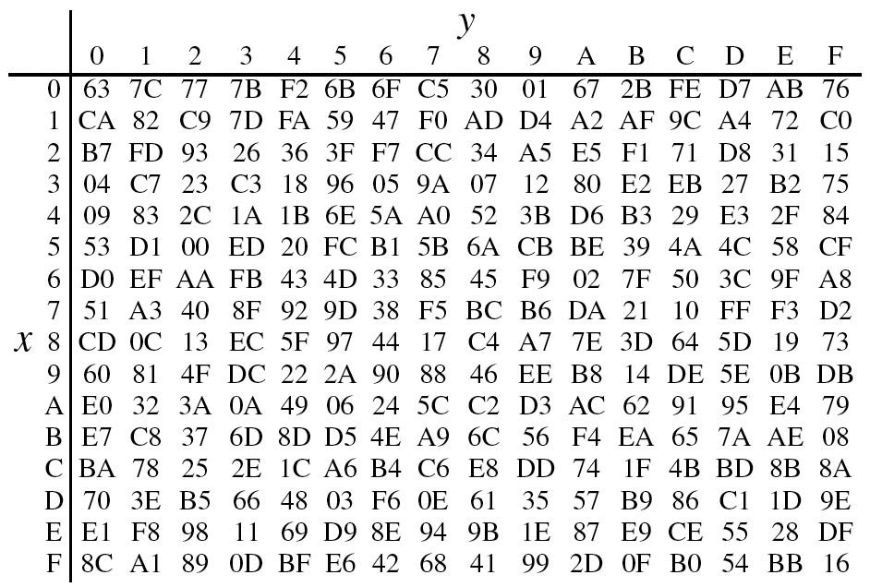
AES S-box
Example 4.8. Let’s assume the input byte to the S-box is A_{i} = (C2)_{hex}, then the substituted value is S((C2)_{hex}) = (25)_{hex}

Slide 14
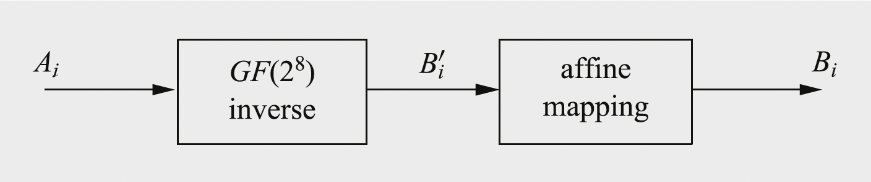
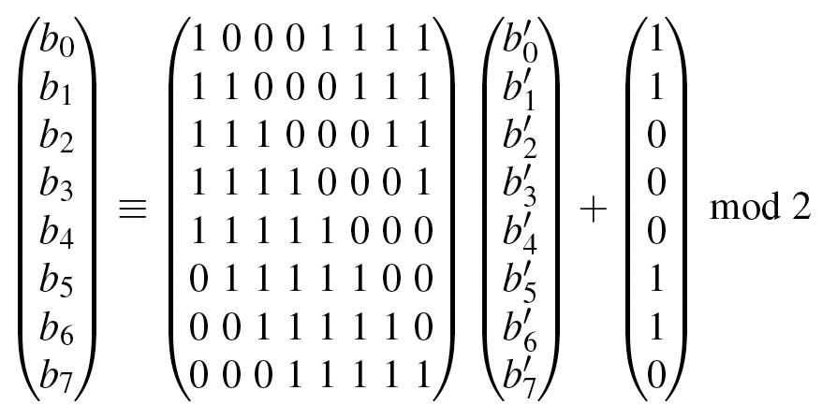
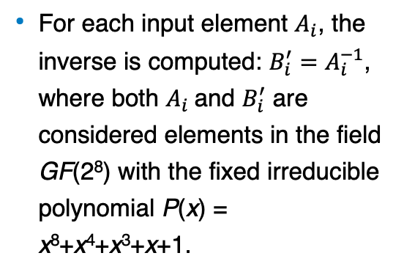
The two operations within the AES S-box
An AES S-box can be viewed as a twostep mathematical transformation, as shown in the following Figure
For each input element $A_{i}$, the inverse is computed: $B_{i}^{′}=$ $A_{i}^{−1}$, where both $A_{i}$and $B_{i}^{′}$ are considered elements in the field GF(2⁸) with the fixed irreducible polynomial P(x) = x⁸+x⁴+x³+x+1.

Slide 15
Diffusion Layer
The Diffusion layer
provides diffusion over all input state bits
consists of two sublayers:
ShiftRows Sublayer: Permutation of the data on a byte level
MixColumn Sublayer: Matrix operation which combines (“mixes”) blocks of four bytes
performs a linear operation on state matrices A, B, i.e., DIFF(A) + DIFF(B) = DIFF(A + B)

Slide 16
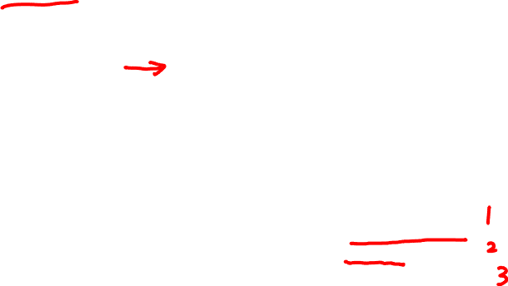
ShiftRows Sublayer
Rows of the state matrix are shifted cyclically:
Input matrix
Output matrix
B₀ | B₄ | B₈ | B₁₂
B₁ | B₅ | B₉ | B₁₃
B₂ | B₆ | B₁₀ | B₁₄
B₃ | B₇ | B₁₁ | B₁₅
B₀ | B₄ | B₈ | B₁₂
B₅ | B₉ | B₁₃ | B₁
B₁₀ | B₁₄ | B₂ | B₆
B₁₅ | B₃ | B₇ | B₁₁
no shift
← one position left shift
← two positions left shift
← three positions left shift

Slide 17
MixColumn Sublayer
Linear transformation which mixes each column of the state matrix
Each 4-byte column is considered as a vector and multiplied by a fixed 4x4 matrix, e.g.,
where 01, 02 and 03 are given in hexadecimal notation
All arithmetic is done in the Galois field GF(2⁸) (for more information see Chapter 4.3 in Understanding Cryptography)

Slide 18
Key Addition Layer
Inputs:
16-byte state matrix C
16-byte subkey k_{i}
Output: C ⊕ k_{i}
The subkeys are generated in the key schedule

Slide 19
Key Schedule
Subkeys are derived recursively from the original 128/192/256-bit input key
Each round has 1 subkey, plus 1 subkey at the beginning of AES
Key whitening: Subkey is used both at the input and output of AES ⇒ # subkeys = # rounds + 1
There are different key schedules for the different key sizes
Key length (bits) | Number of subkeys
128 | 11
192 | 13
256 | 15

Slide 20
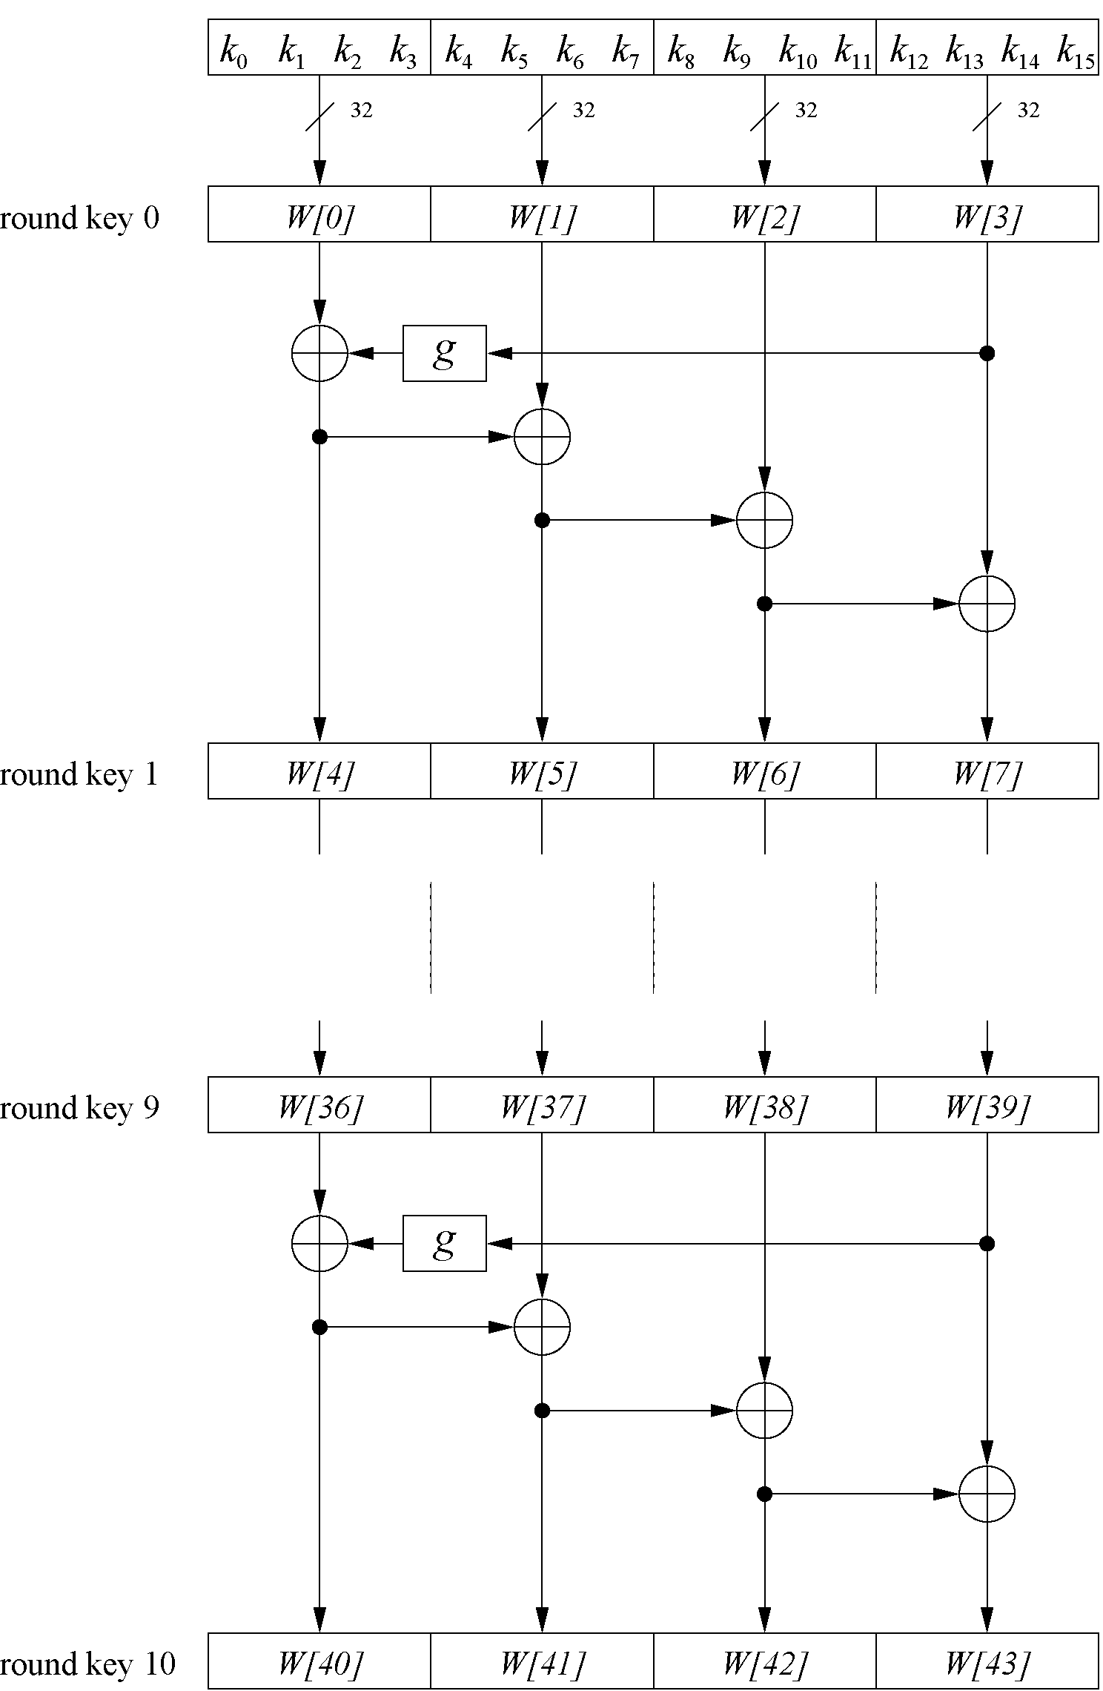
Key Schedule
Example: Key schedule for 128-bit key AES
Word-oriented: 1 word = 32 bits
11 subkeys are stored in W[0]…W[3], W[4]…W[7], … , W[40]…W[43]
First subkey W[0]…W[3] is the original AES key

Slide 21
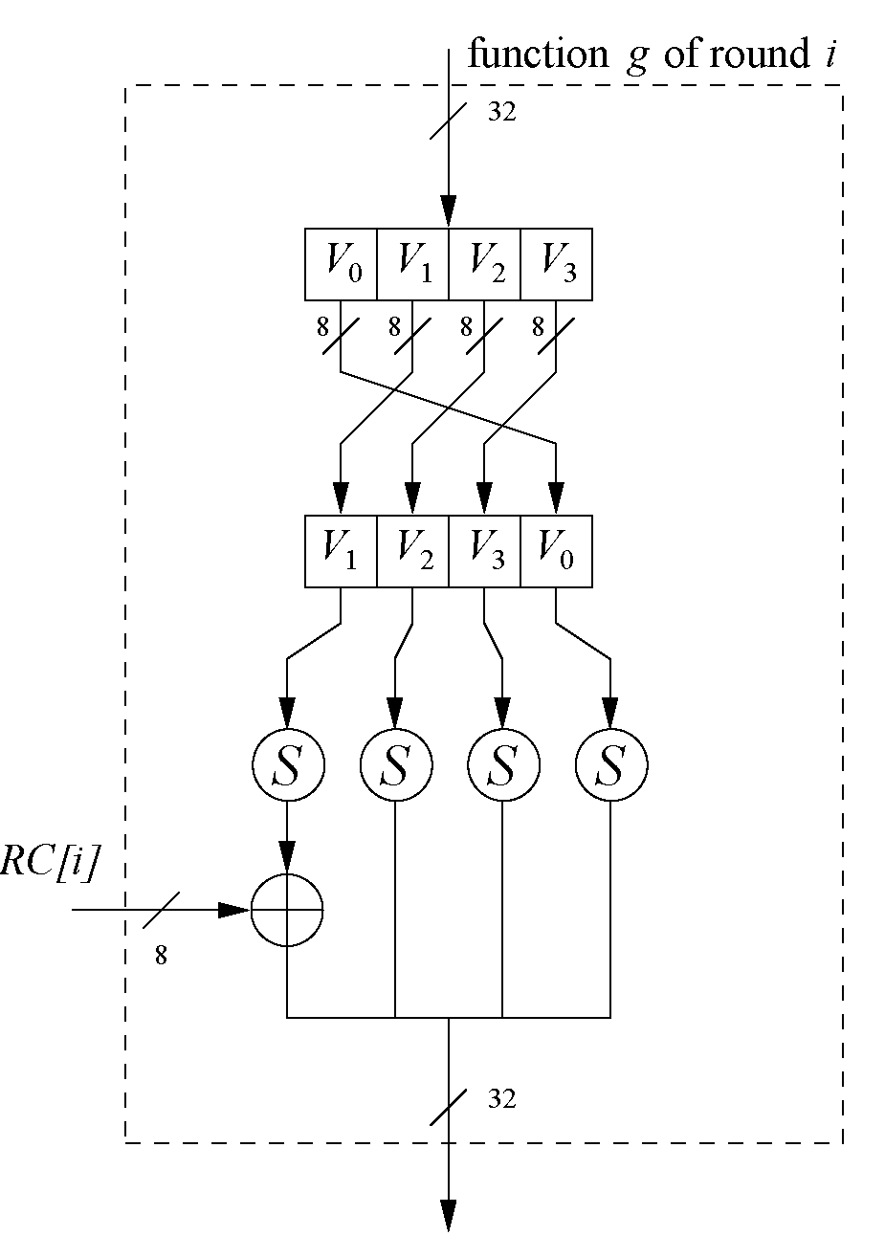
Key Schedule
Function g rotates its four input bytes and performs a bytewise S-Box substitution ⇒ nonlinearity
The round coefficient RC is only added to the leftmost byte and varies from round to round: RC[1] = x⁰ = (00000001)₂ RC[2] = x¹ = (00000010)₂ RC[3] = x² = (00000100)₂ ... RC[10] = x⁹ = (00110110)₂
x^{i} represents an element in a Galois field (again, cf. Chapter 4.3 of Understanding Cryptography)

Slide 22
Content of this Chapter
Overview of the AES algorithm
Internal structure of AES
Byte Substitution layer
Diffusion layer
Key Addition layer
Key schedule
Decryption
Practical issues

Slide 23
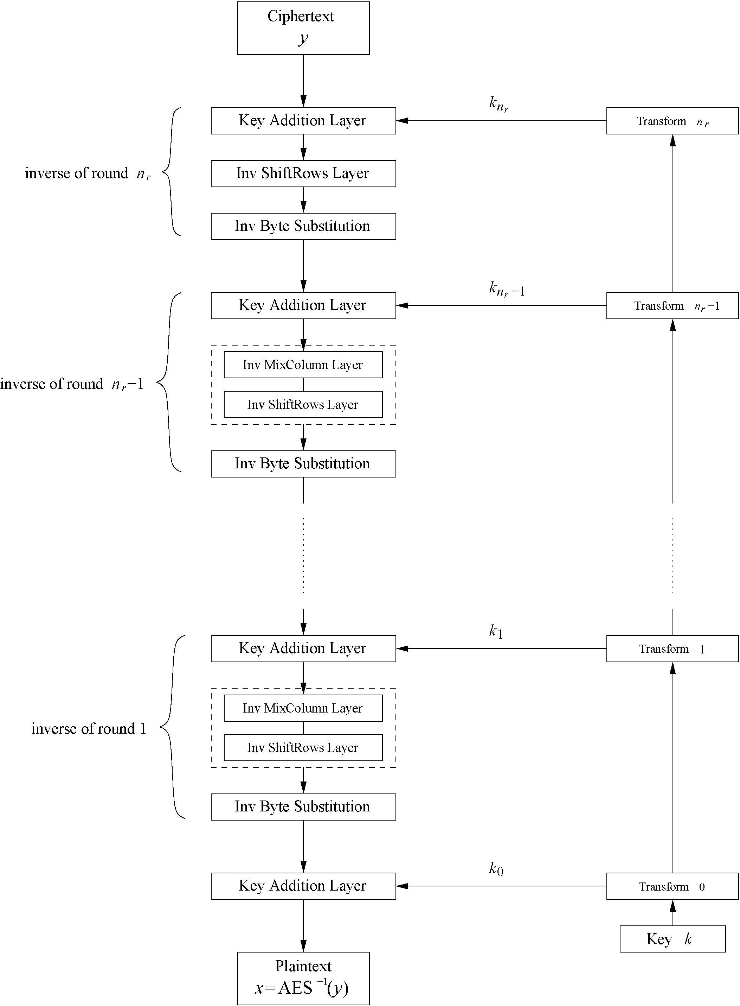
Decryption
AES is not based on a Feistel network
⇒ All layers must be inverted for decryption:
MixColumn layer → Inv MixColumn layer
ShiftRows layer→ Inv ShiftRows layer
Byte Substitution layer → Inv Byte Substitution layer
Key Addition layer is its own inverse

Slide 24
Decryption
Inv MixColumn layer:
To reverse the MixColumn operation, each column of the state matrix C must be multiplied with the inverse of the 4x4 matrix, e.g.,
where 09, 0B, 0D and 0E are given in hexadecimal notation
Again, all arithmetic is done in the Galois field GF(2⁸) (for more information see Chapter 4.3 in Understanding Cryptography)

Slide 25
Decryption
Inv ShiftRows layer:
All rows of the state matrix B are shifted to the opposite direction:
Input matrix
Output matrix
B₀ | B₄ | B₈ | B₁₂
B₁ | B₅ | B₉ | B₁₃
B₂ | B₆ | B₁₀ | B₁₄
B₃ | B₇ | B₁₁ | B₁₅
B₀ | B₄ | B₈ | B₁₂
B₁₃ | B₁ | B₅ | B₉
B₁₀ | B₁₄ | B₂ | B₆
B₇ | B₁₁ | B₁₅ | B₃
no shift
→ one position right shift
→ two positions right shift
→ three positions right shift

Slide 26
Decryption
Inv Byte Substitution layer:
Since the S-Box is bijective, it is possible to construct an inverse, such that
A_{i} = S⁻¹(B_{i}) = S⁻¹(S(A_{i}))
⇒ The inverse S-Box is used for decryption. It is usually realized as a lookup table
Decryption key schedule:
Subkeys are needed in reversed order (compared to encryption)
In practice, for encryption and decryption, the same key schedule is used. This requires that all subkeys must be computed before the encryption of the first block can begin

Slide 27
Content of this Chapter
Overview of the AES algorithm
Internal structure of AES
Byte Substitution layer
Diffusion layer
Key Addition layer
Key schedule
Decryption
Practical issues

Slide 28
Implementation in Software
One requirement of AES was the possibility of an efficient software implementation
Straightforward implementation is well suited for 8-bit processors (e.g., smart cards), but inefficient on 32-bit or 64-bit processors
A more sophisticated approach: Merge all round functions (except the key addition) into one table look-up
This results in four tables with 256 entries, where each entry is 32 bits wide
One round can be computed with 16 table look-ups
Typical SW speeds are more than 1.6 Gbit/s on modern 64-bit processors

Slide 29
Security
Brute-force attack: Due to the key length of 128, 192 or 256 bits, a brute-force attack is not possible
Analytical attacks: There is no analytical attack known that is better than brute-force
Side-channel attacks:
Several side-channel attacks have been published
Note that side-channel attacks do not attack the underlying algorithm but the implementation of it

Slide 30

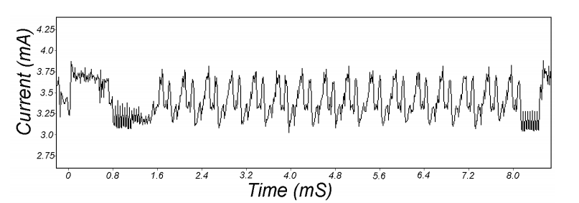
Attacks on the implementation
1. Side channel attacks:
Measure time to do enc/dec, measure power for enc/dec
2. Fault attacks:
Computing errors in the last round expose the secret key k
⇒ do not even implement crypto primitives yourself …
smartcard
[Kocher, Jaffe, Jun, 1998]
Notes:
Many timing attacks: cache timing, multi-core attacks, smartcard attacks

Slide 31
Lessons Learned
AES is a modern block cipher which supports three key lengths of 128, 192 and 256 bit. It provides excellent long-term security against brute-force attacks.
AES has been studied intensively since the late 1990s and no attacks have been found that are better than brute-force.
AES is not based on Feistel networks. Its basic operations use Galois field arithmetic and provide strong diffusion and confusion.
AES is part of numerous open standards such as IPsec or TLS, in addition to being the mandatory encryption algorithm for US government applications. It seems likely that the cipher will be the dominant encryption algorithm for many years to come.
AES is efficient in software and hardware.

Slide 32
Avalanche Effect in A E S: Change in Plaintext (1 of 2)
Round |  | Number of Bits that Differ
 | 0123456789abcdeffedcba9876543210 0023456789abcdeffedcba9876543210 | 1
0 | 0e3634aece7225b6f26b174ed92b5588 0f3634aece7225b6f26b174ed92b5588 | 1
1 | 657470750fc7ff3fc0e8e8ca4dd02a9c c4a9ad090fc7ff3fc0e8e8ca4dd02a9c | 20
2 | 5c7bb49a6b72349b05a2317ff46d1294 fe2ae569f7ee8bb8c1f5a2bb37ef53d5 | 58
3 | 7115262448dc747e5cdac7227da9bd9c ec093dfb7c45343d689017507d485e62 | 59
4 | f867aee8b437a5210c24c1974cffeabc 43efdb697244df808e8d9364ee0ae6f5 | 61
5 | 721eb200ba06206dcbd4bce704fa654e 7b28a5d5ed643287e006c099bb375302 | 68
Notes:
Using the example from Table 6.5, Table 6.6 shows the result when the eighth bit of the plaintext is changed. The second column of the table shows the value of the State matrix at the end of each round for the two plaintexts. Note that after just one round, 20 bits of the State vector differ. After two rounds, close to half the bits differ. This magnitude of difference propagates through the remaining rounds. A bit difference in approximately half the positions in the most desirable outcome. Clearly, if almost all the bits are changed, this would be logically equiva- lent to almost none of the bits being changed. Put another way, if we select two plaintexts at random, we would expect the two plaintexts to differ in about half of the bit positions and the two ciphertexts to also differ in about half the positions.

Slide 33
Avalanche Effect in A E S: Change in Plaintext (2 of 2)
Round |  | Number of Bits that Differ
6 | 0ad9d85689f9f77bc1c5f71185e5fb14 3bc2d8b6798d8ac4fe36a1d891ac181a | 64
7 | db18a8ffa16d30d5f88b08d777ba4eaa 9fb8b5452023c70280e5c4bb9e555a4b | 67
8 | f91b4fbfe934c9bf8f2f85812b084989 20264e1126b219aef7feb3f9b2d6de40 | 65
9 | cca104a13e678500ff59025f3bafaa34 b56a0341b2290ba7dfdfbddcd8578205 | 61
10 | ff0b844a0853bf7c6934ab4364148fb9 612b89398d0600cde116227ce72433f0 | 58
Notes:
Using the example from Table 6.5, Table 6.6 shows the result when the eighth bit of the plaintext is changed. The second column of the table shows the value of the State matrix at the end of each round for the two plaintexts. Note that after just one round, 20 bits of the State vector differ. After two rounds, close to half the bits differ. This magnitude of difference propagates through the remaining rounds. A bit difference in approximately half the positions in the most desirable outcome. Clearly, if almost all the bits are changed, this would be logically equiva- lent to almost none of the bits being changed. Put another way, if we select two plaintexts at random, we would expect the two plaintexts to differ in about half of the bit positions and the two ciphertexts to also differ in about half the positions.

Slide 34
Avalanche Effect in A E S: Change in Key (1 of 2)
Round |  | Number of Bits that Differ
 | 0123456789abcdeffedcba9876543210 0123456789abcdeffedcba9876543210 | 0
0 | 0e3634aece7225b6f26b174ed92b5588 0f3634aece7225b6f26b174ed92b5588 | 1
1 | 657470750fc7ff3fc0e8e8ca4dd02a9c c5a9ad090ec7ff3fc1e8e8ca4cd02a9c | 22
2 | 5c7bb49a6b72349b05a2317ff46d1294 90905fa9563356d15f3760f3b8259985 | 58
3 | 7115262448dc747e5cdac7227da9bd9c 18aeb7aa794b3b66629448d575c7cebf | 67
4 | f867aee8b437a5210c24c1974cffeabc f81015f993c978a876ae017cb49e7eec | 63
5 | 721eb200ba06206dcbd4bce704fa654e 5955c91b4e769f3cb4a94768e98d5267 | 81
Notes:
Table 6.7 shows the change in State matrix values when the same plaintext is used and the two keys differ in the eighth bit. That is, for the second case, the key is 0e1571c947d9e8590cb7add6af7f6798. Again, one round produces a significant change, and the magnitude of change after all subsequent rounds is roughly half the bits. Thus, based on this example, AES exhibits a very strong avalanche effect.
Note that this avalanche effect is stronger than that for DES (Table 4.2), which requires three rounds to reach a point at which approximately half the bits are changed, both for a bit change in the plaintext and a bit change in the key.

Slide 35
Avalanche Effect in A E S: Change in Key (2 of 2)
Round |  | Number of Bits that Differ
6 | 0ad9d85689f9f77bc1c5f71185e5fb14 dc60a24d137662181e45b8d3726b2920 | 70
7 | db18a8ffa16d30d5f88b08d777ba4eaa fe8343b8f88bef66cab7e977d005a03c | 74
8 | f91b4fbfe934c9bf8f2f85812b084989 da7dad581d1725c5b72fa0f9d9d1366a | 67
9 | cca104a13e678500ff59025f3bafaa34 0ccb4c66bbfd912f4b511d72996345e0 | 59
10 | ff0b844a0853bf7c6934ab4364148fb9 fc8923ee501a7d207ab670686839996b | 53
Notes:
Table 6.7 shows the change in State matrix values when the same plaintext is used and the two keys differ in the eighth bit. That is, for the second case, the key is 0e1571c947d9e8590cb7add6af7f6798. Again, one round produces a significant change, and the magnitude of change after all subsequent rounds is roughly half the bits. Thus, based on this example, AES exhibits a very strong avalanche effect.
Note that this avalanche effect is stronger than that for DES (Table 4.2), which requires three rounds to reach a point at which approximately half the bits are changed, both for a bit change in the plaintext and a bit change in the key.

Slide 36
中国商用密码算法SM4
SM4算法描述

Slide 37
SM4算法描述
SM4算法是用于WAPI的分组密码算法，是2006年我国国家密码管理局公布的国内第一个商用密码算法。
SM4算法是分组密码算法，其中数据分组长度为128比特，密钥分组长度也为128比特。加密算法与密钥扩展算法都采用32轮迭代结构，以字节（8位）和字（32位）为单位进行数据处理。

Slide 38
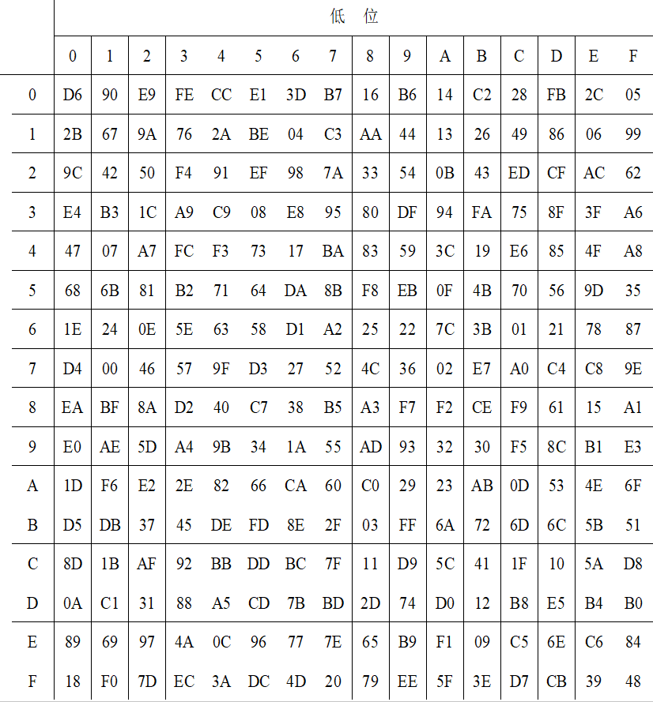
SM4算法描述
基本运算
SM4密码算法的S盒

Slide 39
SM4算法描述
SM4密码算法的基本运算有模2加和循环移位。
① 模2加：记为 ，为32位逐比特异或运算。
② 循环移位： i，把32位字循环左移i位。
基本密码部件
⑴ S盒
S盒是以字节为单位的非线性替换，其密码学作用是混淆，它的输入和输出都是8位的字节。设输入字节为 ,输出字节为， 则S盒的运算可表示为：
S盒的替换规则如表3-11所示。例如输入为EF，则输出为第E行与第F列交叉处的值84，即 。

Slide 40
SM4算法描述
⑵ 非线性变换
非线性变换 是以字为单位的非线性替换，它由4个S盒并置构成。设输入为 （4个32位的字），输出为 （4个32位的字），则
（3-1）
(3) 线性变换部件
线性变换部件 是以字为处理单位的线性变换，其输入输出都是32位的字，它的密码学作用是扩散。
设 的输入为字 ，输出为字 ，则
（3-2）

Slide 41
SM4算法描述
(4）合成变换
合成变换 由非线性变换 和线性变换 复合而成，数据处理的单位是字。设输入为字 ，则先对
进行非线性 变换，再进行线性 变换。记为
（3-3）
由于合成变换 是非线性变换 和线性变换 的复合，所以它综合起到混淆和扩散的作用，从而可提高密码的安全性。

Slide 42
SM4算法描述
轮函数
轮函数由上述基本密码部件构成。设轮函数 的输入为4个32位字 ，共128位，轮密钥为一个32位的字 。输出也是一个32位的字，由下式给出：
根据式（3-3），有
记 ，根据式（3-1）和式（3-2），有
轮函数的结构见图3-24。

Slide 43
SM4算法描述
图3-24 SM4算法的加密算法和轮函数结构图

Slide 44
SM4算法描述
加密算法
加密算法采用32轮迭代结构，每轮使用一个轮密钥。
设输入的明文为四个字 （128比特长），输入的轮密钥为 ，共32个字。输出的密文为四个字 （128比特长）。加密算法可描述如下：
为了与解密算法需要的顺序一致，同时也与人们的习惯顺序一致，在加密算法之后还需要一个反序处理 ：
（3-4）

Slide 45
SM4算法描述
解密算法
解密算法与加密算法相同，只是轮密钥的使用顺序相反，解密轮密钥是加密轮密钥的逆序。
算法的输入为密文 和轮密钥 ，输出为明文 。根据式 。为了便于与加密算法对照，解密算法中仍然用 表示密文。于是可得到如下的解密算法。
解密算法：
与加密算法之后需要一个反序处理同样的道理，在解密算法之后也需要一个反序处理 ：

Slide 46
SM4算法描述
密钥扩展算法
SM4算法加密时输入128位的密钥，采用32轮迭代结构，每一轮使用一个32位的轮密钥，共使用32个轮密钥。使用密钥扩展算法，从加密密钥产生出32个轮密钥。
（1）常数
在密钥扩展中使用如下的常数：
（2）固定参数
共使用32个固定参数 ，每个 是一个字，其产生规则如下：
设 为 的第 字节 ，即
，则

Slide 47
SM4算法描述
这32个固定参数如下（16进制）：

Slide 48
SM4算法描述
密钥扩展算法
设输入的加密密钥为 ，输出轮密钥为 ，密钥扩展算法可描述如下，其中 为中间数据：
其中的变换 与加密算法轮函数中的 基本相同，只将其中的线性变化 修改为以下的 ：
密钥扩展算法的结构与加密算法的结构类似，也是采用了32轮的迭代处理。

